Slide 1

Finding High Value Canola Farmland
Agricultural Insights from Saskatchewan and Manitoba
By Clinton Boyda Oct 2023

Slide 2
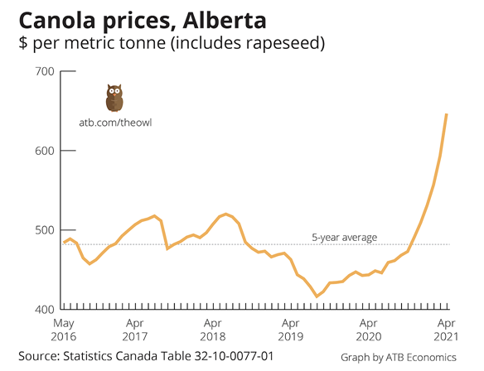
Agricultural Insights
Objective:
Leverage Canola public stock price to calculate the value from yield data.
Value = Crop Yield x Stock Price
Scope:
397 Rural Municipalities (RM)
Year 2010-2022 from SK and MB

Slide 3

Problem Statement
Let’s go shopping for the best Canola Valued Farmland!
Where is the Top 10 Canola Yield RM locations?
Where is the Top 10 Canola Valued RM locations?
Are there any trends or discrepancies between yield and value?

Slide 4
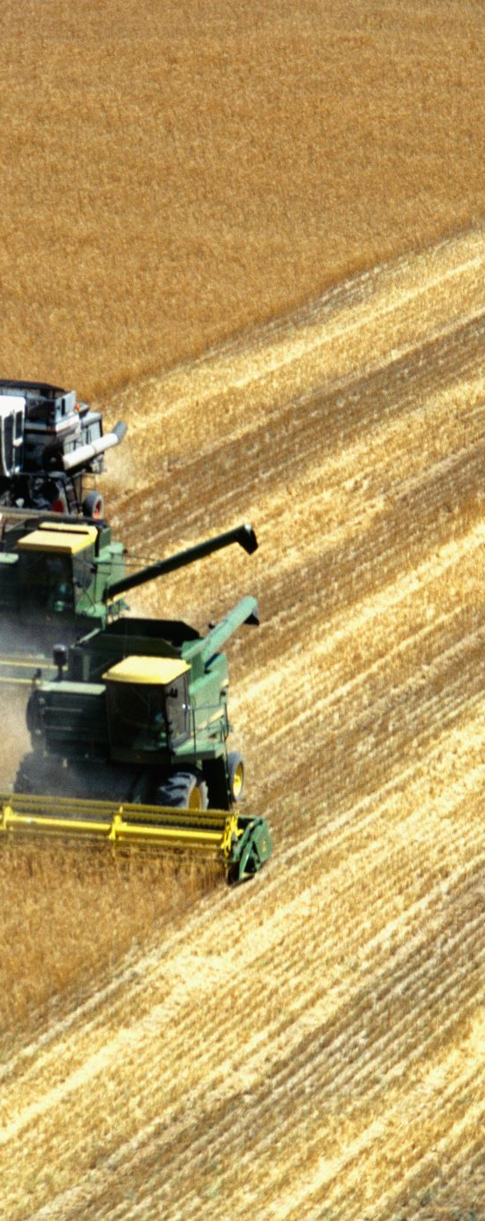
Data Collection & Preprocessing
Crop Yield Data for 397 RM’s from Provincial Data Sources
Geospatial Data found for 478 RMs but 4 still missing from Yield list
Canola Future Stock Price from Investing.com limited to 2010-2022
Transformed Yield to Bushels, Cleaned GIS RM names, Converted $ per Bushel
Scaled Yield and Value for GIS Comparison as % Diff

Slide 5
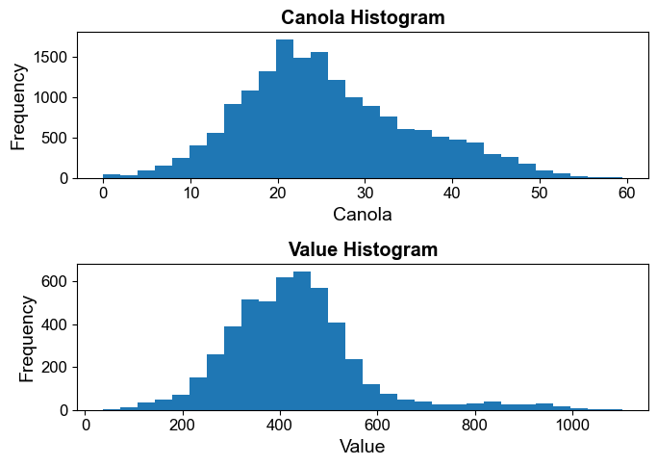
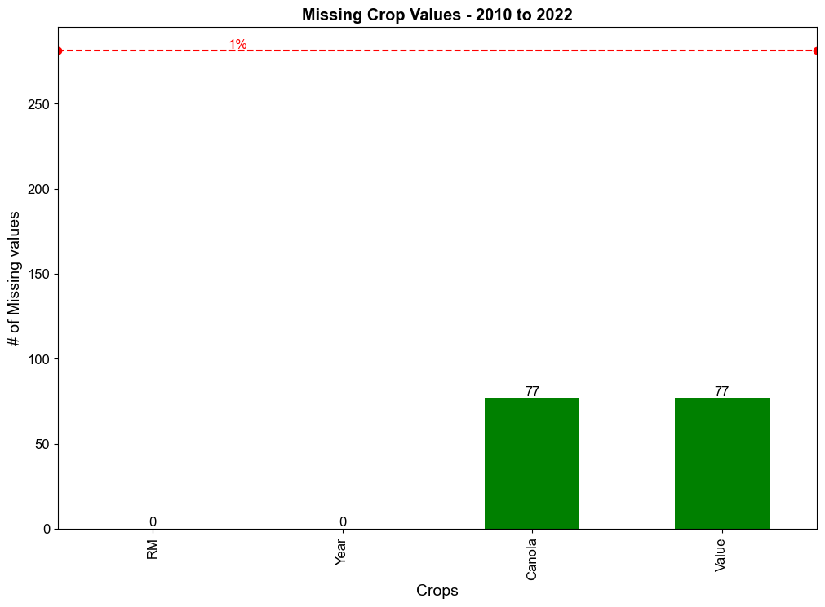
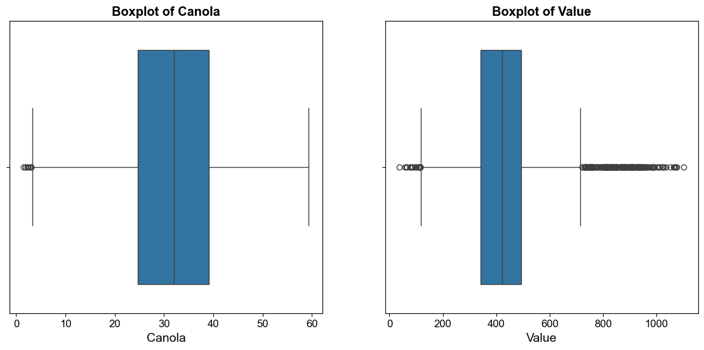
Exploratory Data Analysis (EDA)
Quality of our Yield and Value Data

Slide 6
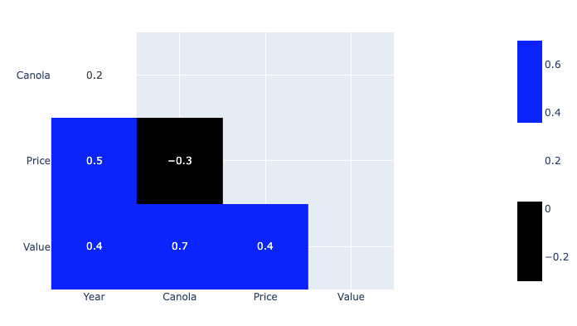
Exploratory Data Analysis (EDA)
Correlation Matrix shows several positive correlations

Slide 7
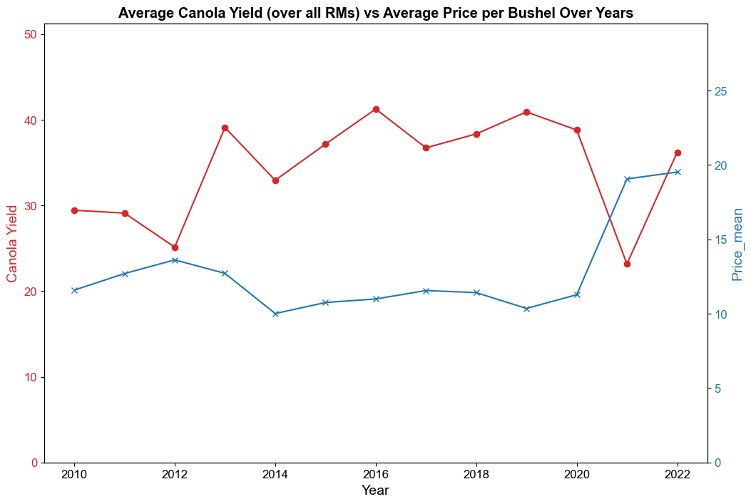
Exploratory Data Analysis (EDA)
Relationship between Canola Crop Yields and Stock Price Over Time

Slide 8
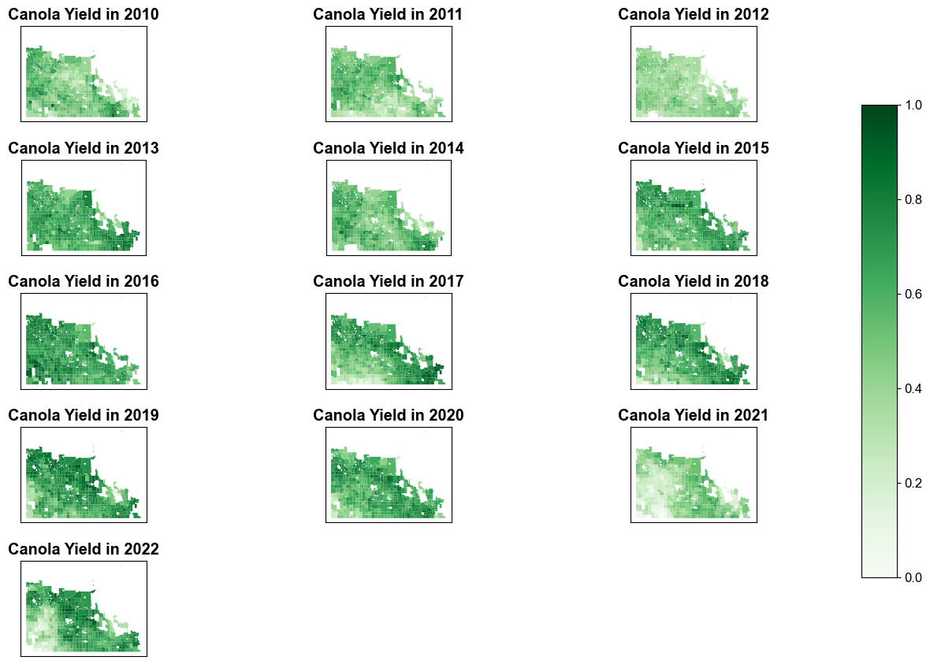
Exploratory Data Analysis (EDA)
Explore Choropleth Maps by RM and Year for Canola Crop Yields

Slide 9
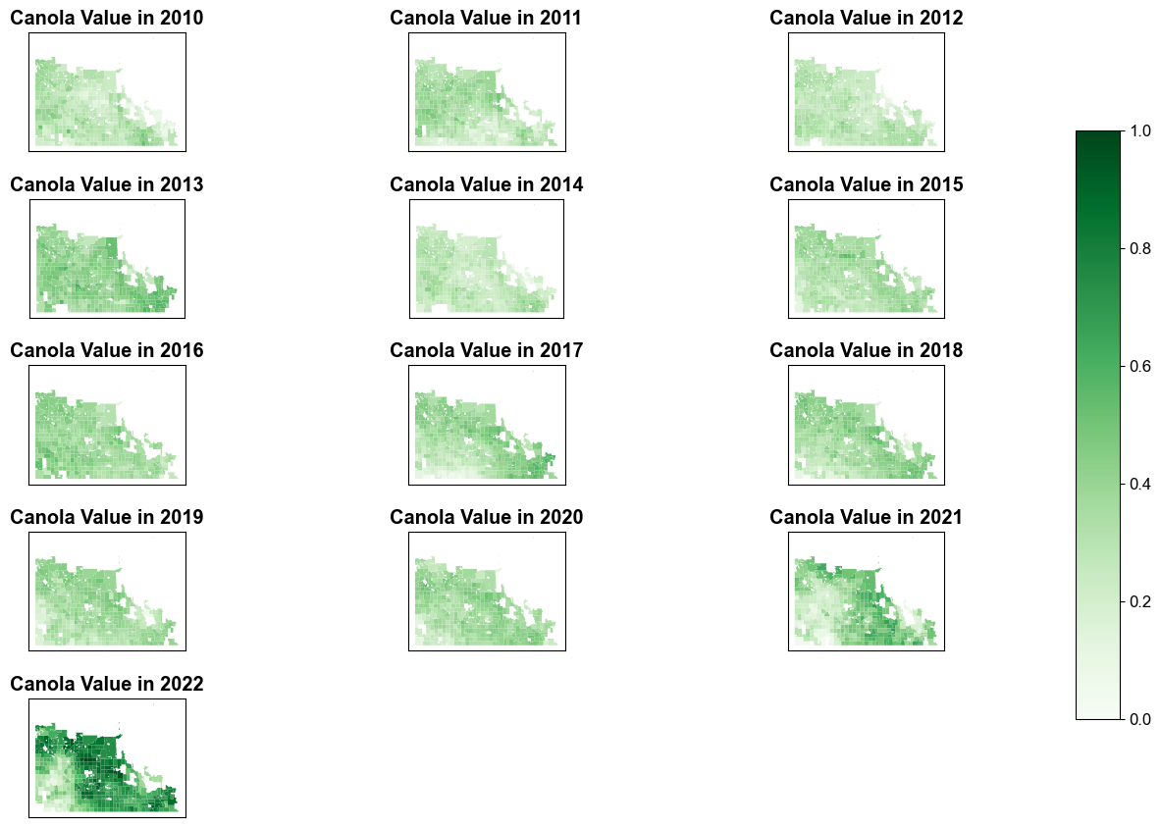
Exploratory Data Analysis (EDA)
Explore Choropleth Maps by RM and Year for Canola Crop Values

Slide 10
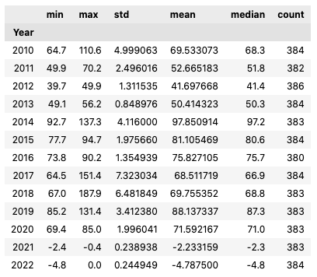
Exploratory Data Analysis (EDA)
Percentage Difference of Value vs Yield over Time Analysis
Range: Lowest in 2021 (-2-0.4%) to Highest in 2014 (93-137%) and 2018 (67-188%) indicates significant fluctuations
STD: Greatest variability 2014 & 2018, also Best aka highest Mean vs 21/22
Mean~Median mostly similar suggesting not heavily skewed except ‘21 & ‘22 where yield was lower than its value
2017 stands out as highest STD, explore?

Slide 11
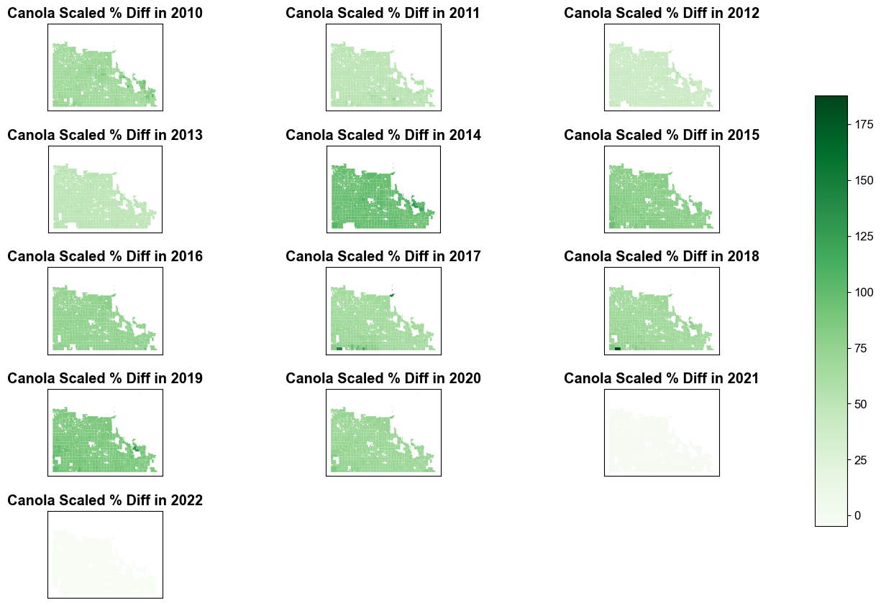
Exploratory Data Analysis (EDA)
Percentage Difference of Value vs Yield over Time
Highest STD
LOW
LOW

Slide 12
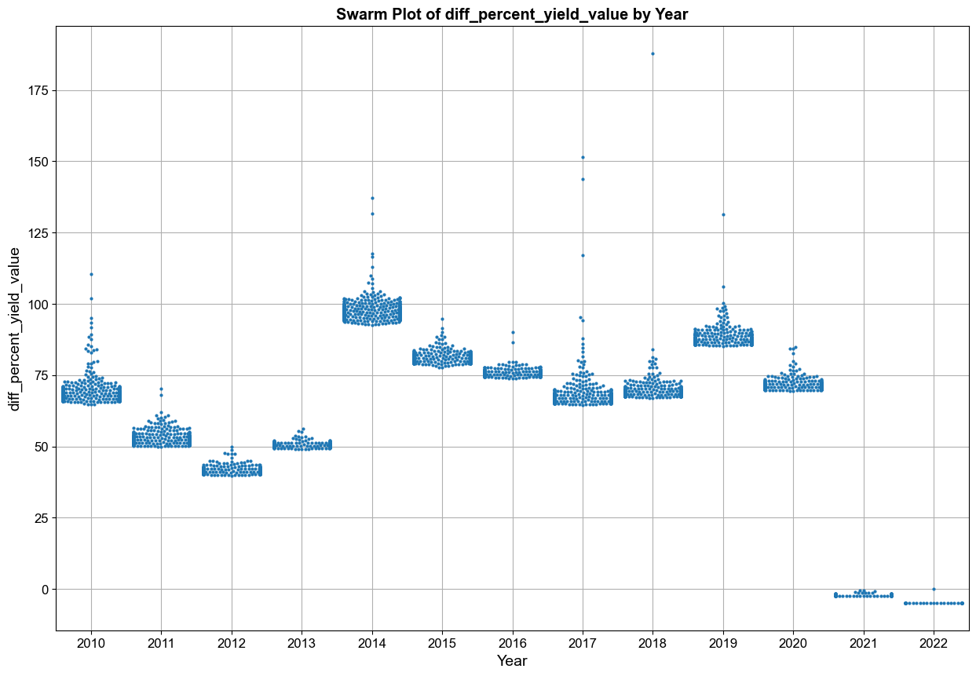
Exploratory Data Analysis (EDA)
Swarm Plot of same % Difference between Value and Yield over Time

Slide 13
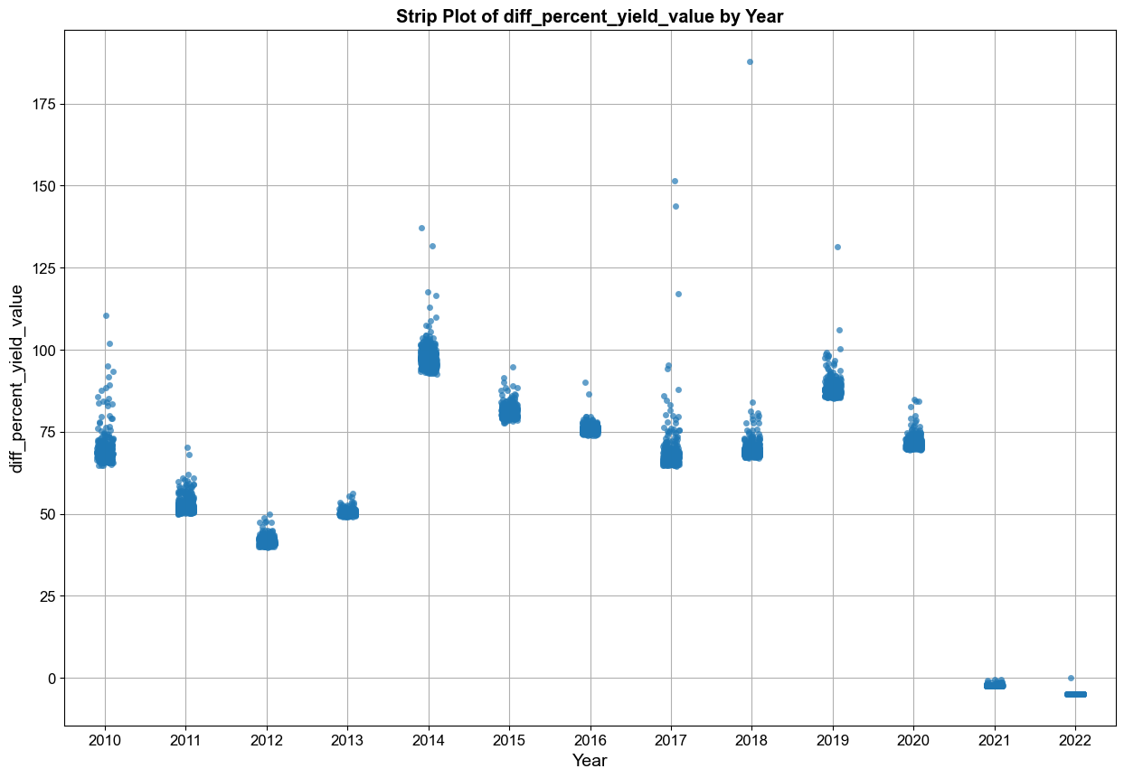
Exploratory Data Analysis (EDA)
Swarm Plot of same % Difference between Value and Yield over Time

Slide 14
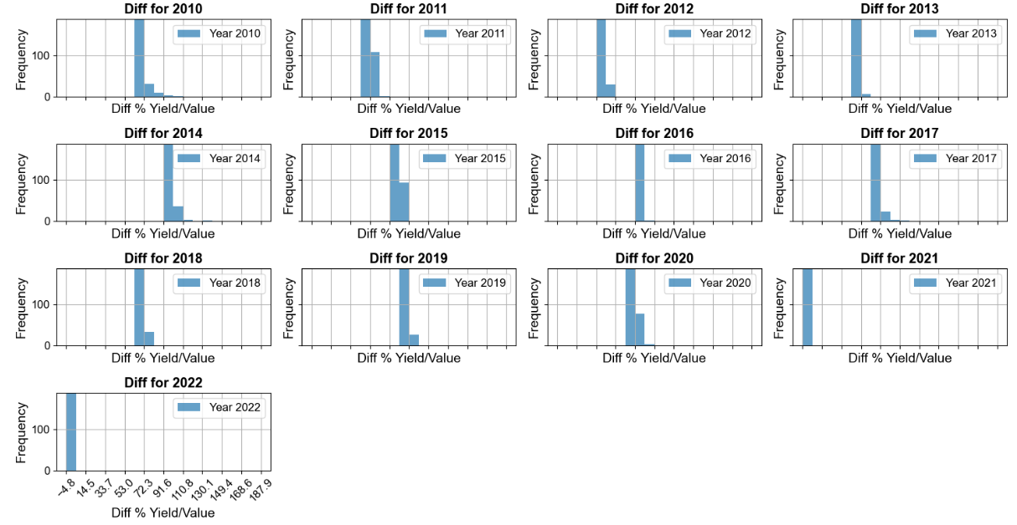
Exploratory Data Analysis (EDA)
Histographs of % Difference between Value and Yield
Range: Lowest in 2021/22 to Highest in 2014 and 2019 indicates significant fluctuations
STD: Greatest variability 2014 & 2018; Best 2021/22

Slide 15
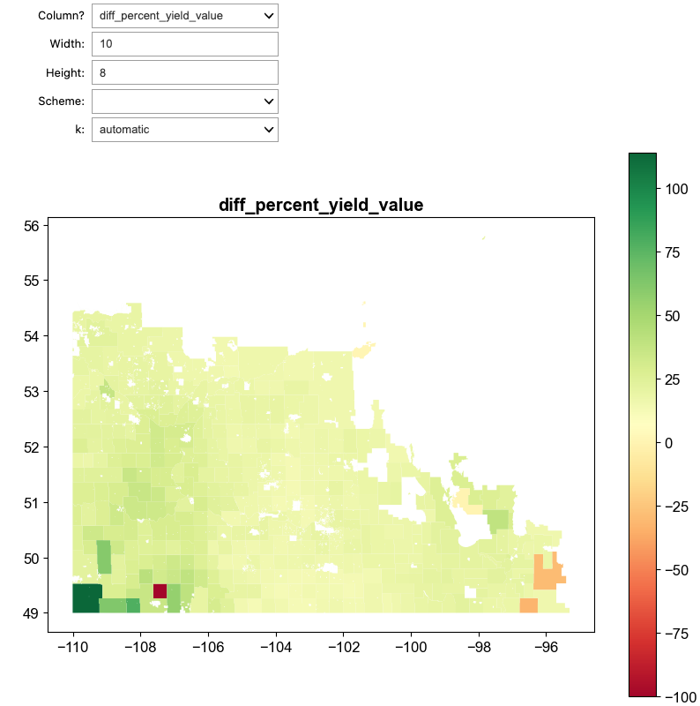
Interactive Python
Choropleth of Selectable Column / Scheme / k
Details on 3 negative RMs (for future analysis?):
For RM 46, the Canola yield had a mean of 16.79 with a standard deviation of 11.77, while the Value had a mean of 224.02 with a standard deviation of 113.11. The Canola was scaled to 0.00, and the Value was scaled to 0.04. The Diff %is -100.00, indicating a decrease.
For RM REYNOLDS, the Canola yield had a mean of 36.55 with a standard deviation of 11.19, while the Value had a mean of 629.82 with a standard deviation of 313.03. The Canola was scaled to 0.71, and the Value was scaled to 1.00. The Diff %is -29.20, indicating a decrease.
For RM STUARTBURN, the Canola yield had a mean of 29.34 with a standard deviation of 13.38, while the Value had a mean of 490.84 with a standard deviation of 377.04. The Canola was scaled to 0.45, and the Value was scaled to 0.67. The Diff %is -32.80, indicating a decrease.

Slide 16
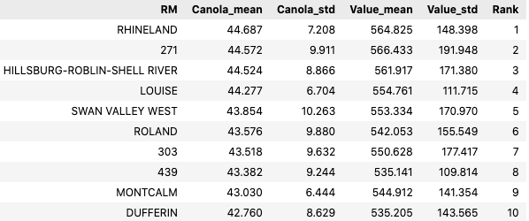
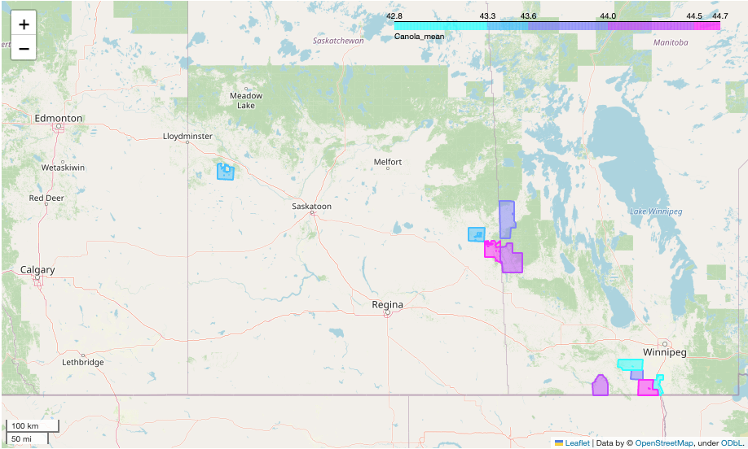
Top 10 Interactive Map
Canola RM’s by YIELD

Slide 17
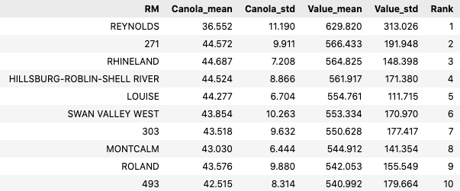
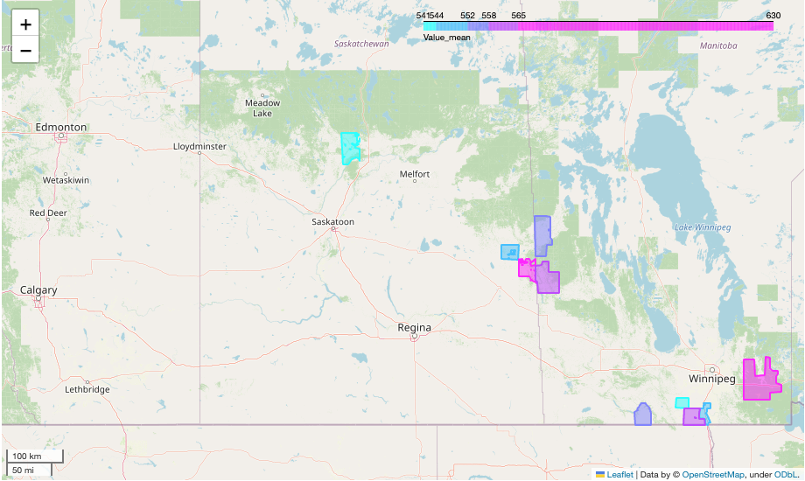
Top 10 Interactive Map
Canola RM’s by VALUE

Slide 18
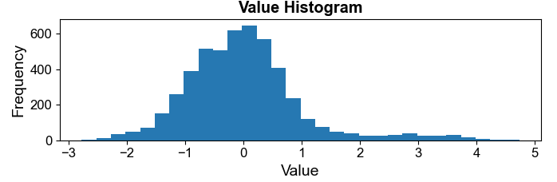
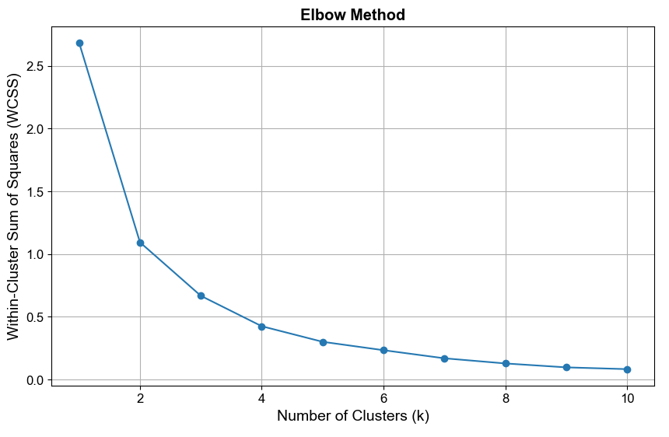
Unsupervised Machine Learning
K-Means Clustering of Scaled Value
Using Elbow Method: Selecting k=2 and k=4

Slide 19
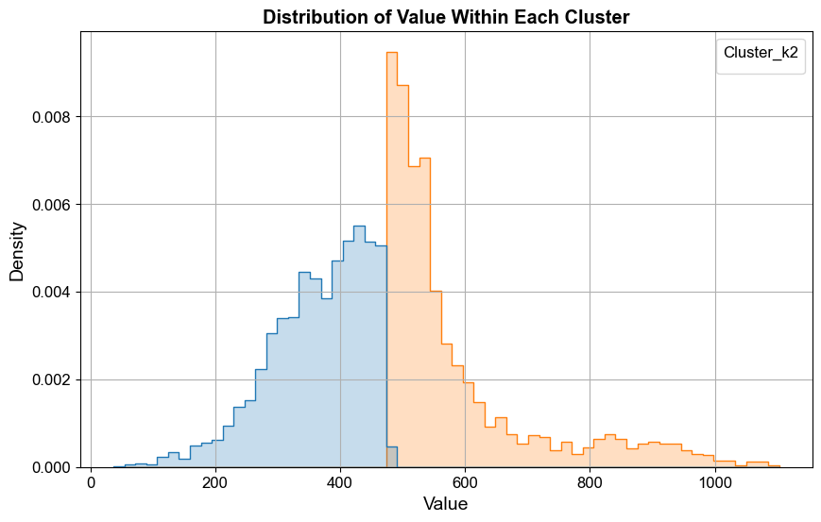
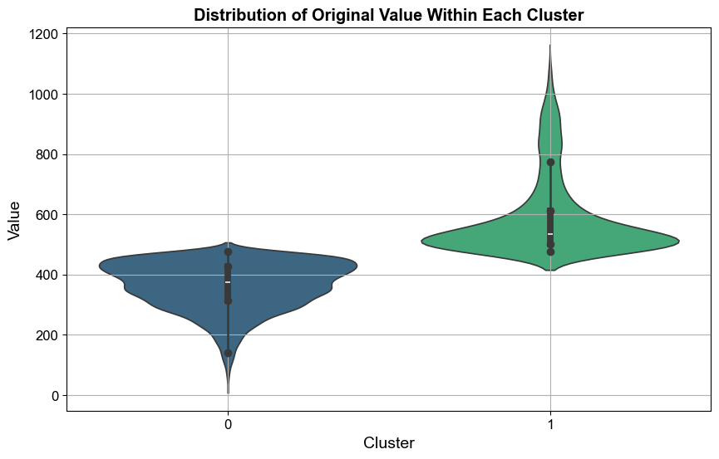
Unsupervised Machine Learning
K-Means Clustering with k=2

Slide 20
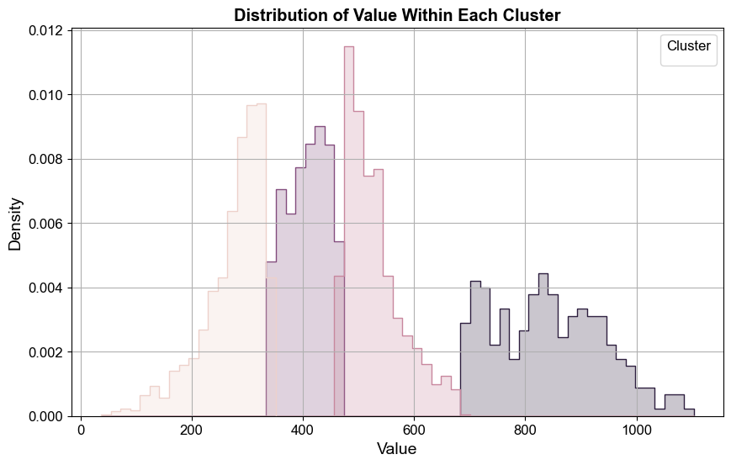
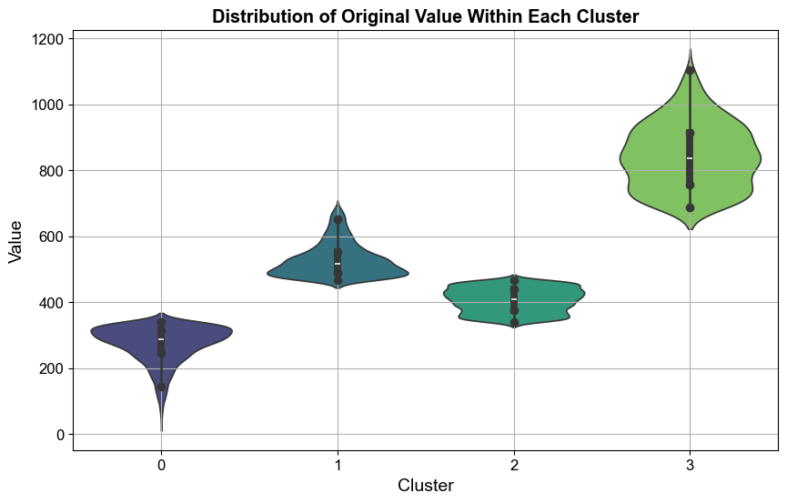
Unsupervised Machine Learning
K-Means Clustering with k=2

Slide 21
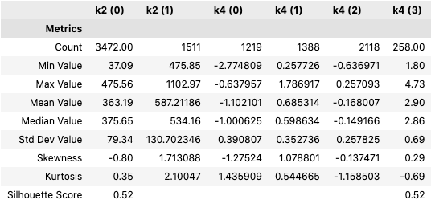
Unsupervised Machine Learning
K-Means Clustering of k=2 and k=4
Overall, both k=2 and k=4 offer valuable but different perspectives on the data segmentation. The choice between them may depend on the specific needs of further analysis or domain-specific interpretation.

Slide 22
Results
Interactive Python Widget
HTML Interactive Files for Exploration
Visualizations:
Geospatial Choropleths
Time Series Line Charts
Comparative Histograms
Provide in-depth Canola yield vs value

Slide 23
Conclusions
After Identifying the Yearly trends a Percentage Difference was used to highlight which years showed variability.
Trends found in Canola over time
Correlation was demonstrated between Yield and Value
Next Steps?
Explore more regional specific pricing for value calculations vs public stock price.
Consider other correlations including real estate prices and even municipal tax rates.

